Slide 1
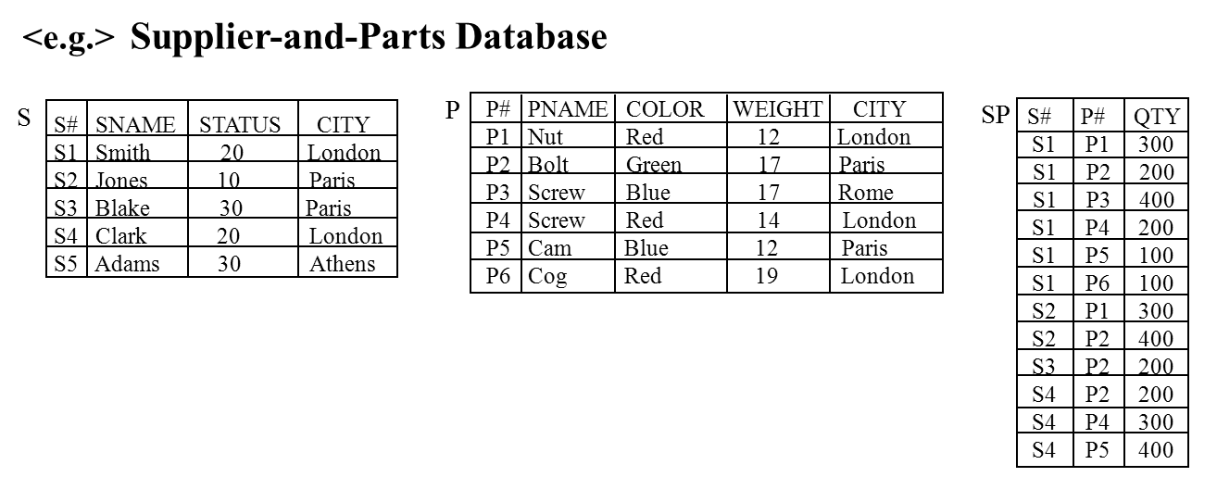
Unit 3 The Relational Model

Slide 2
Outline
3.1 Introduction
3.2 Relational Data Structure
3.3 Relational Integrity Rules
3.4 Relational Algebra
3.5 Relational Calculus

Slide 3
3.1 Introduction

Slide 4
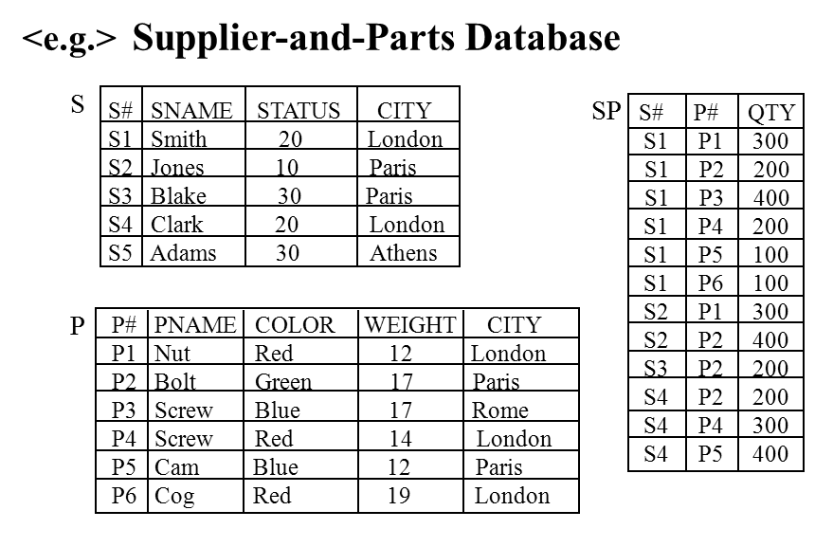
Relational Model [Codd, 1970]
A way of looking at data
A prescription for
representing data: by means of tables
manipulating that representation: by select, join, ...
Relational DBMS
<e.g.> DB2, INGRES, SYBASE, Oracle, mySQL
Relational Data Model

Slide 5
Relational Model (cont.)
Concerned with three aspects of data:
1. Data structure: tables
2. Data integrity: primary key rule, foreign key rule
3. Data manipulation: (Relational Operators):
Relational Algebra (See Section 3.4)
Relational Calculus (See Section 3.5)
Basic idea: relationship expressed in data values, not in link structure.
<e.g.> Entity Relationship Entity
Mark Works_in Math_Dept
WORKS_IN
Name
Mark
Dept
Math_Dept

Slide 6
Terminologies
Relation : so far corresponds to a table.
Tuple : a row of such a table.
Attribute : a column of such a table.
Cardinality : number of tuples.
Degree : number of attributes.
Primary key : an attribute or attribute combination that uniquely identify a tuple.
Domain : a pool of legal values.
S# NAME STATUS CITY
London
Paris
etc.
>
Domains
Primary key
S#
S1
S2
S3
S4
S5
SNAME
Smith
Jones
Blake
Clark
Adams
STATUS
20
10
30
20
30
CITY
London
Paris
Paris
London
Athens
Cardinality
Relation
<
Tuples
Attributes
Degree

Slide 7
3.2 Relational Data Structure
Three aspects of Relational Model:
1. Data structure: Tables
2. Data integrity: Primary key rule, Foreign key rule
3. Data manipulation: Relational Operators

Slide 8
Relations
Definition : A relation on domains D₁, D₂, ..., D_{n} (not necessarily all distinct) consists of a heading and a body.
heading
body
Heading : a fixed set of attributes A₁,....,A_{n} such that A_{j} underlying domain D_{j} (j=1...n) .
Body: a time-varying set of tuples.
Tuple: a set of attribute-value pairs.
{A₁:Vi₁, A₂:Vi₂,..., A_{n}:Vi_{n}}, where I = 1...m or
S# SNAME STATUS CITY
S1 Smith 20 London
S4 Clark 20 London

Slide 9
Domain
Domain: a set of scalar values with the same type.
Scalar: the smallest semantic unit of data, atomic, nondecomposable.
Domain-Constrained Comparisons: two attributes defined on the same domain, then comparisons and hence joins, union, etc. will make sense.
<e.g.>
SELECT P.*, SP.* SELECT P.*, SP.* FROM P, SP FROM P, SP WHERE P.P#=SP.P# WHERE P.Weight=SP.Qty
same domain different domain
A system that supports domain will prevent users from making silly mistakes.

Slide 10
Domain (cont.)
Domain should be specified as part of the database definition.
<e.g.> Supplier-and-Parts Database
<e.g.>
CREATE DOMAIN S# CHAR(5)
CREATE DOMAIN NAME CHAR(20)
CREATE DOMAIN STATUS SMALLINT;
CREATE DOMAIN CITY CHAR(15)
CREATE DOMAIN P# CHAR(6)
CREATE TABLE S
(S# DOMAIN (S#) Not Null
SNAME DOMAIN (NAME),
.
.
CREATE TABLE P
(P# DOMAIN (P#) Not Null,
PNAME DOMAIN (NAME).
.
.
CREATE TABLE SP
(S# DOMAIN (S#) Not Null,
P# DOMAIN (P#) Not Null,
.
.
S
S# SNAME STATUS CITY
S1 Smith 20 London
S2 Jones 10 Paris
S3 Blake 30 Paris
S4 Clark 20 London
S5 Adams 30 Athens
SP
S# P# QTY
S1 P1 300
S1 P2 200
S1 P3 400
S1 P4 200
S1 P5 100
S1 P6 100
S2 P1 300
S2 P2 400
S3 P2 200
S4 P2 200
S4 P4 300
S4 P5 400
P
P# PNAME COLOR WEIGHT CITY
P1 Nut Red 12 London
P2 Bolt Green 17 Paris
P3 Screw Blue 17 Rome
P4 Screw Red 14 London
P5 Cam Blue 12 Paris
P6 Cog Red 19 London

Slide 11
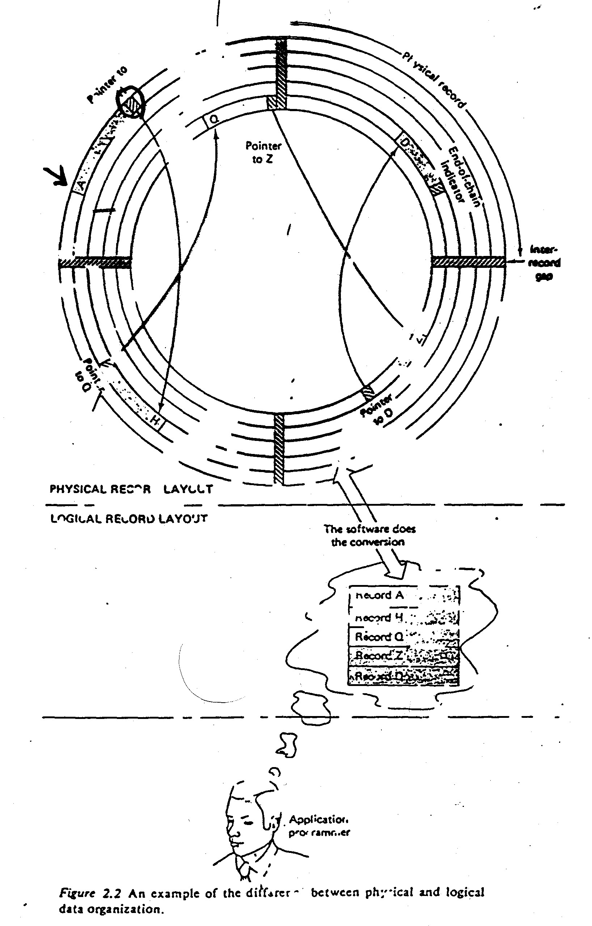
Properties of Relations
There are no duplicate tuples: since relation is a mathematical set.
Corollary : the primary key always exists.
(at least the combination of all attributes of
the relation has the uniqueness property.)
Tuples are unordered.
Attributes are unordered.
All attribute values are atomic.
i.e. There is only one value, not a list of values
at every row-and-column position within the table.
i.e. Relations do not contain repeating groups.
i.e. Relations are normalized.
S
S# SNAME STATUS CITY
S1 Smith 20 London
S2 Jones 10 Paris
S3 Blake 30 Paris
S4 Clark 20 London
S5 Adams 30 Athens

Slide 12
Properties of Relations (cont.)
Normalization
S#
S1
S2
S3
S4
PQ
{ (P1,300),
(P2, 200),
(P3, 400),
(P4, 200),
(P5, 100),
(P6, 100) }
{ (P1, 300),
(P2, 400) }
{ (P2, 200) }
{ (P2, 200),
(P4, 300),
(P5, 400) }
S#
S1
S1
S1
S1
S1
S1
S2
S2
S3
S4
S4
S4
P#
P1
P2
P3
P4
P5
P6
P1
P2
P2
P2
P4
P5
QTY
300
200
400
200
100
100
300
400
200
200
300
400
1NF
“fact”
Normalized
degree : 2 - degree: 3
domains: - domains:
S# = {S1, S2, S3, S4} S# = {S1, S2, S3, S4}
PQ = {<p,q> | p∈{P1, P2, ..., P6} P# = {P1, P2, ..., P6}
q ∈{x| 0≤ x ≤1000}} QTY = {x| 0≤ x ≤1000}} - a mathematical relation - a mathematical relation

Slide 13
Reason for normalizing a relation: Simplicity!!
S#
S1
S2
S3
S4
PQ
{ (P1,300),
(P2, 200),
(P3, 400),
(P4, 200),
(P5, 100),
(P6, 100) }
{ (P1, 300),
(P2, 400) }
{ (P2, 200) }
{ (P2, 200),
(P4, 300),
(P5, 400) }
S#
S1
S1
S1
S1
S1
S1
S2
S2
S3
S4
S4
S4
P#
P1
P2
P3
P4
P5
P6
P1
P2
P2
P2
P4
P5
QTY
300
200
400
200
100
100
300
400
200
200
300
400
“fact”
Un-normalized
Normalized
Normalized
<e.g.> Consider two transactions T1, T2:
Transaction T1 : insert ('S5', 'P6' , 500)
Transaction T2 : insert ('S4', 'P6', 500)
There are difference:
Un-normalized: two operations (one insert, one append)
Normalized: one operation (insert)

Slide 14
Kinds of Relations
Base Relations (Real Relations): a named, atomic relation; a direct part of the database. e.g. S, P
Views (Virtual Relations): a named, derived relation; purely represented by its definition in terms of other named relations.
Snapshots: a named, derived relation with its own stored data.
<e.g.>
CREATE SNAPSHOT SC
AS SELECT S#, CITY
FROM S
REFRESH EVERY DAY;
A read-only relation.
Periodically refreshed
Query Results: may or may not be named, no persistent existence within the database.
Intermediate Results: result of subquery, typically unnamed.
Temporary Relations: a named relation, automatically destroyed at some appropriate time.
London Supplier
LS
View
Relation
S
P
Base table
OP
Relation

Slide 15
Relational Databases
Definition: A Relational Database is a database that is perceived by the users as a collection of time-varying, normalized relations.
Perceived by the users: the relational model apply at the external and conceptual levels.
Time-varying: the set of tuples changes with time.
Normalized: contains no repeating group (only contains atomic value).
The relational model represents a database system at a level of abstraction that removed from the details of the underlying machine, like high-level language.
C, Java ,PL/1
DBMS environments
assembler
Relational DBMS
machine
Relational
Data Model

Slide 16
3.3 Relational Integrity Rules
Purpose:
to inform the DBMS of certain constraints in the real world.

Slide 17
Keys
Candidate keys: Let R be a relation with attributes A₁, A₂, ..., A_{n}. The set of attributes K (A_{i}, A_{j}, ..., A_{m}) of R is said to be a candidate key iff it satisfies:
Uniqueness: At any time, no two tuples of R have the same value for K.
Minimum: none of A_{i}, A_{j}, ... A_{k} can be discarded from K without destroying the uniqueness property.
<e.g.> S# in S is a candidate key.
(S#, P#) in SP is a candidate key.
(S#, CITY) in S is not a candidate key.
Primary key: one of the candidate keys.
Alternate keys: candidate keys which are not the primary key.
<e.g.> S#, SNAME: both are candidate keys
S#: primary key
SNAME: alternate key.
Note: Every relation has at least one candidate key.
S
S# SNAME STATUS CITY
S1 Smith 20 London
S2 Jones 10 Paris
S3 Blake 30 Paris
S4 Clark 20 London
S5 Adams 30 Athens
SP
S# P# QTY
S1 P1 300
S1 P2 200
S1 P3 400
S1 P4 200
S1 P5 100
S1 P6 100
S2 P1 300
S2 P2 400
S3 P2 200
S4 P2 200
S4 P4 300
S4 P5 400

Slide 18
Foreign keys (p.261 of C. J . Date)
Foreign keys: Attribute FK (possibly composite) of base relation R2 is a foreign keys iff it satisfies:
1. There exists a base relation R1 with a candidate key CK, and
2. For all time, each value of FK is identical to the value of CK in some tuple in the current value of R1.
CK
P (R1)
P#
P1
P2
P3
P4
PNAME
.
.
.
.
. . .
.
.
.
.
S (R1)
S#
S1
S2
S3
SNAME
.
.
.
. . .
.
.
.
reference
reference
SP (R2)
S#
S1
S1
S2
S2
S2
P#
P2
P4
P1
P2
P4
QTY
.
.
.
.
.
Foreign keys, FK

Slide 19
Two Integrity Rules of Relational Model
Rule 1: Entity Integrity Rule
No component of the primary key of a base relation is allowed to accept nulls.
Rule 2: Referential Integrity Rule
The database must not contain any unmatched foreign key values.
Note: Additional rules which is specific to the database can be given.
<e.g.> QTY = { 0~1000}
However, they are outside the scope of the relational model.
S
S# SNAME STATUS CITY
S1 Smith 20 London
S2 Jones 10 Paris
S3 Blake 30 Paris
S4 Clark 20 London
S5 Adams 30 Athens
SP
S# P# QTY
S1 P1 300
S1 P2 200
S1 P3 400
S1 P4 200
S1 P5 100
S1 P6 100
S2 P1 300
S2 P2 400
S3 P2 200
S4 P2 200
S4 P4 300
S4 P5 400

Slide 20
Foreign Key Statement
Descriptive statements:
FOREIGN KEY (foreign key) REFERENCES target
NULLS [NOT] ALLOWED
DELETE OF target effect
UPDATE OF target-primary-key effect;
effect: one of {RESTRICTED, CASCADES, NULLIFIES}
<e.g.1> (p.269)
CREATE TABLE SP
(S# S# NOT NULL, P# P# NOT NULL,
QTY QTY NOT NULL,
PRIMARY KEY (S#, P#),
FOREIGN KEY (S#) REFERENCE S
ON DELETE CASCADE
ON UPDATE CASCADE,
FOREIGN KEY (P#) REFERENCE P
ON DELETE CASCADE
ON UPDATE CASCADE,
CHECK (QTY>0 AND QTY<5001));
CK
S (R1)
S#
S1
S2
S3
SNAME
.
.
.
. . .
.
.
.
P (R1)
P#
P1
P2
P4
PNAME
.
.
.
. . .
.
.
.
reference
reference
SP (R2)
S#
S1
S1
S2
S2
S2
P#
P2
P4
P1
P2
P4
QTY
.
.
.
.
.
Foreign keys, FK

Slide 21
How to avoid against the referential Integrity Rule?
Delete rule: what should happen on an attempt to delete/update target of a foreign key reference
RESTRICTED
CASCADES
NULLIFIES
<e.g.> User issues:
DELETE FROM S WHERE S#='S1'
System performs:
Restricted:
Reject!
Cascades:
DELETE FROM SP WHERE S#='S1'
Nullifies:
UPDATE SP SET S#=Null WHERE S#='S1'
S
S# SNAME STATUS CITY
S1 Smith 20 London
S2 Jones 10 Paris
S3 Blake 30 Paris
S4 Clark 20 London
S5 Adams 30 Athens
SP
S# P# QTY
S1 P1 300
S1 P2 200
S1 P3 400
S1 P4 200
S1 P5 100
S1 P6 100
S2 P1 300
S2 P2 400
S3 P2 200
S4 P2 200
S4 P4 300
S4 P5 400
FOREIGN KEY (S#) REFERENCE S
ON DELETE CASCADE
ON UPDATE CASCADE,
S
SP
S1
S1
S1
Cascade!!

Slide 22
3.4 Relational Algebra
Three aspects of Relational Model:
1. Data structure: Tables
2. Data integrity: Primary key rule, Foreign key rule
3. Data manipulation: Relational Operators
Relational Algebra
Relational Calculus

Slide 23
3.4.1 Introduction to Relational Algebra
The relational algebra consists of a collection of eight high-level operators that operate on relations [defined by Codd, 1970]
Traditional set operations:
Union (∪)
Intersection (∩)
Difference (−)
Cartesian Product / Times (x)
Special relational operations:
Restrict (σ) or Selection
Project (Π)
Join ( )
Divide (÷)
<e.g.> Supplier-and-Parts Database
S
S# SNAME STATUS CITY
S1 Smith 20 London
S2 Jones 10 Paris
S3 Blake 30 Paris
S4 Clark 20 London
S5 Adams 30 Athens
SP
S# P# QTY
S1 P1 300
S1 P2 200
S1 P3 400
S1 P4 200
S1 P5 100
S1 P6 100
S2 P1 300
S2 P2 400
S3 P2 200
S4 P2 200
S4 P4 300
S4 P5 400
P
P# PNAME COLOR WEIGHT CITY
P1 Nut Red 12 London
P2 Bolt Green 17 Paris
P3 Screw Blue 17 Rome
P4 Screw Red 14 London
P5 Cam Blue 12 Paris
P6 Cog Red 19 London

Slide 24
Relational Operators
Union (∪)
Intersection (∩)
Difference (−)

Slide 25
Relational Operators (cont.)
Restrict (σ)
Project (Π)
Product (x)
a
b
c
x
y
a
a
b
b
c
c
x
y
x
y
x
y
(Natural)
Join
Cartesian Product / Times (x)
Divide (÷)
R1
x
y
R2 z
w
x y z w
a1 b1 b1 c1
a1 b1 b2 c2
a1 b1 b3 c3
a2 b1 b1 c1
. . . .
. . . .
. . . .
a1
a2
a3
b1
b1
b2
b1
b2
b3
c1
c2
c3
a1
a2
a3
b1
b1
b2
c1
c1
c2
a
a
a
b
c
x
y
z
x
y
x
z
a
R1
R2
R1 x R2
y=z

Slide 26
Relational Algebra: property of closure
The relational algebra consists of a collection of eight high-level operators that operate on relations.
Each operator takes relations (one or two) as operands and produce a relation as result.
the important property of closure.
nested relational expression is possible.
<e.g.> R3 = σ(R1 R2)
{{0,1,2,3},+}
Integer
+ 0 1 2 3
0 0 1 2 3
1 1 2 3 4
2 2 3 4 5
3 3 4 5 6
{I; +, -, *}
objects
T₁ ←R₁ join R₂
R₃ ←T₁ selection
NOT Closure!
+ 0 1 2 3
0 0 1 2 3
1 1 2 3 0
2 2 3 0 1
3 3 1 0 2
1+2 = 3 ∈ N
5+8 = 13 ∈ N closure!
{relations; OP1, OP2, ..., OP8}
Closure!

Slide 27
SQL vs. Relational Operators
A SQL SELECT contains several relational operators.
<e.g.>
SQL: SELECT S#, SNAME
FROM S, SP
WHERE S.S# = SP.S#
AND CITY = 'London ‘
AND QTY > 200
SQL
Language
processor
algebra
(intermediate form)
Code generator
Object code
1> S _{S#} SP
2> σ_{CITY ='London', QTY>200}
3> Π_{S#,SNAME}
=
Π _{S#, SNAME} (σ _{CITY='London', QTY>200} (S _{S#} SP))

Slide 28
3.4.2 Traditional Set Operations
Union Compatibility: two relations are union compatible iff they have identical headings.
i.e.: 1. they have same set of attribute name.
2. corresponding attributes are defined on the same domain.
objective: ensure the result is still a relation.
Union (∪), Intersection (∩) and Difference (−) require Union Compatibility, while Cartesian Product (X) don't.
A
S# SNAME STATUS CITY
S1 Smith 20 London
S4 Clark 20 London
B
S# SNAME STATUS CITY
S1 Smith 20 London
S2 Jones 10 Paris
A ∪ B
S# SNAME STATUS CITY
S1 Smith 20 London
S2 Jones 10 Paris
S4 Clark 20 London

Slide 29
Traditional Set Operations: UNION
A, B: two union-compatible relations.
A : (X₁,...,X_{m})
B : (X₁,...,X_{m})
A UNION B:
Heading: (X₁,...,X_{m})
Body: the set of all tuples t belonging to either A or B (or both).
Association:
(A ∪ B ) ∪ C = A ∪ ( B ∪ C)
Commutative:
A ∪ B = B ∪ A
A
S# SNAME STATUS CITY
S1 Smith 20 London
S4 Clark 20 London
B
S# SNAME STATUS CITY
S1 Smith 20 London
S2 Jones 10 Paris
A ∪ B
S# SNAME STATUS CITY
S1 Smith 20 London
S2 Jones 10 Paris
S4 Clark 20 London

Slide 30
Traditional Set Operations: INTERSECTION
A, B: two union-compatible relations.
A : (X₁,...,X_{m})
B : (X₁,...,X_{m})
A INTERSECT B:
Heading: (X₁,...,X_{m})
Body: the set of all tuples t belonging to both A and B.
Association:
(A ∩ B) ∩ C = A ∩ (B ∩ C)
Commutative:
A ∩ B = B ∩ A
A
S# SNAME STATUS CITY
S1 Smith 20 London
S4 Clark 20 London
B
S# SNAME STATUS CITY
S1 Smith 20 London
S2 Jones 10 Paris
A ∩ B
S# SNAME STATUS CITY
S1 Smith 20 London

Slide 31
Traditional Set Operations: DIFFERENCE
A, B: two union-compatible relations.
A : (X₁,...,X_{m})
B : (X₁,...,X_{m})
A MINUS B:
Heading: (X₁,...,X_{m})
Body: the set of all tuples t belonging to A and not to B.
Association: No!
(A − B) − C ≠ A − ( B − C )
Commutative: No!
A − B ≠ B − A
A
S# SNAME STATUS CITY
S1 Smith 20 London
S4 Clark 20 London
B
S# SNAME STATUS CITY
S1 Smith 20 London
S2 Jones 10 Paris
A − B
S# SNAME STATUS CITY
S4 Clark 20 London
B − A
S# SNAME STATUS CITY
S2 Jones 20 London

Slide 32
Traditional Set Operations: TIMES
Extended Cartesian Product (x):
Given:
A = { a | a= (a₁,...,a_{m})}
B = { b | b= (b₁,...,b_{n})}
Mathematical Cartesian product:
A x B = { t | t=((a₁,...,a_{m}),(b₁,...,b_{n}))}
Extended Cartesian Product:
A x B = { t | t= (a₁,...,a_{m},b₁,...,b_{n})}
Coalescing
Product Compatibility: two relations are product-compatible iff their headings are disjoint.
<e.g.1> A (S#, SNAME)
B (P#, PNAME, COLOR)
A and B are product compatible!
math.
A = {x, y}
B = {y, z}
A x B = {(x,y),(x,z),(y,y),(y,z)}
A x B (S#, SNAME, P#, PNAME, COLOR)

Slide 33
Traditional Set Operations: TIMES (cont.)
<e.g.2> S (S#, SNAME, STATUS, CITY)
P (P#, PNAME, COLOR, WEIGHT, CITY)
S and P are not product compatible!
P RENAME CITY AS PCITY;
S x P (S#, ..., CITY, ..., CITY)
S x P (S#, ..., CITY, ..., PCITY)

Slide 34
Traditional Set Operations: TIMES (cont.)
A, B: two product-compatible relations.
A : (X₁,...,X_{m}), A = { a | a = (a₁,...,a_{m})}
B : (Y₁,...,Y_{n}), B = { b | b = (b₁,...,b_{n})}
A TIMES B: (A x B)
Heading: (X₁,...,X_{m,}Y₁,...,Y_{n})
Body: { c | c = (a₁,...,a_{m},b₁,...,b_{n})}
Association:
(A x B) x C = A x (B x C)
Commutative:
A x B = B x A
A X B
S#
S1
S1
S1
S1
S1
S1
S2
.
.
.
S2
S3
.
.
.
S3
S4
.
.
.
S4
S5
.
.
.
S5
P#
P1
P2
P3
P4
P5
P6
P1
.
.
.
P6
P1
.
.
.
P6
P1
.
.
.
P6
P1
.
.
.
P6
A
B
S#
S1
S2
S3
S4
S5
P#
P1
P2
P3
P4
P5
P6
X

Slide 35
3.4.3 Special Relational Operations
Restriction: a unary operator or monadic
Consider: A: a relation, X,Y: attributes or literal
theta-restriction (or abbreviate to just 'restriction'):
A WHERE X theta Y or σ_{X theta Y} (A)
(By Date) (By Ullman)
theta : =, <>, >, >=, <, <=, etc.
The restriction condition (X theta Y) can be extended to be any Boolean combination by including the following equivalences:
(1) σ_{C1 and C2} (A) = σ_{C1} (A) ∩ σ_{C2} (A); (2) σ_{C1 or C2} (A) = σ_{C1} (A) ∪ σ_{C2} (A); (3) σ_{not C} (A) = A − σ_{C} (A)
<e.g.> S WHERE CITY='London'? or σ_{CITY='London'}(S)
A
X Y
(θ)
S
S# SNAME STATUS CITY
S1 Smith 20 London
S2 Jones 10 Paris
S3 Blake 30 Paris
S4 Clark 20 London
S5 Adams 30 Athens
S’
S# SNAME STATUS CITY
S1 Smith 20 London
S4 Clark 20 London

Slide 36
Special Relational Operations: Projection
Projection: a unary operator.
Consider:
A : a relation
X,Y,Z : attributes
A[X,Y,Z] or Π_{X,Y,Z}(A)
Identity projection:
A =A or Π(A) = A
Nullity projection:
A[ ] = ∅ or Π∅(A) = ∅
<e.g.> P[COLOR,CITY]
P
COLOR
Red
Green
Blue
Blue
CITY
London
Paris
Rome
Paris

Slide 37
Special Relational Operations: Natural Join
Natural Join: a binary operator.
Consider:
A : (X₁,...,X_{m}, Y₁,...,Y_{n})
B : (Y₁,...,Y_{n}, Z₁,...,Z_{p})
A JOIN B (or A B): common attributes appear only once. e.g. CITY
(X₁,...,X_{m}, Y₁,...,Y_{n,} Z₁,...,Z_{p});
Association:
(A B ) C = A ( B C )
Commutative:
A B = B A
if A and B have no attribute in common, then
A B = A x B

Slide 38
Special Relational Operations: Natural Join (cont.)
<e.g.> S JOIN P or S P
S.city = P.city
S.city = P.city
S
P
S#
S1
S1
S1
S2
S2
S3
S3
S4
S4
S4
SNAME
Smith
Smith
Smith
Jones
Jones
Blake
Blake
Clark
Clark
Clark
STATUS
20
20
20
10
10
30
30
20
20
20
CITY
London
London
London
Paris
Paris
Paris
Paris
London
London
London
P#
P1
P4
P6
P2
P5
P2
P5
P1
P4
P6
PNAME
Nut
Screw
Cog
Bolt
Cam
Bolt
Cam
Nut
Screw
Cog
COLOR
Red
Red
Red
Green
Blue
Green
Blue
Red
Red
Red
WEIGHT
12
14
19
17
12
17
12
12
14
19
CITY
London

Slide 39
Special Relational Operations: Theta Join
A, B: product-compatible relations, A: (X₁,...,X_{m}), B: (Y₁,...,Y_{n})
theta : =, <>, <, >,.....
A B = σ_{X theta Y}(A x B)
_{X theta Y}
If theta is '=', the join is called equijoin.
<e.g.> a greater-than join
SELECT S.*, P.*
FROM S, P
WHERE S.CITY > P.CITY
σ_{CITY>PCITY}(S x (P RENAME CITY AS PCITY))
S#
S2
S2
S2
S3
S3
S3
SNAME
Jones
Jones
Jones
Blake
Blake
Blake
STATUS
10
10
10
30
30
30
CITY
Paris
Paris
Paris
Paris
Paris
Paris
P#
P1
P4
P6
P1
P4
P6
PNAME
Nut
Screw
Cog
Nut
Screw
Cog
COLOR
Red
Red
Red
Red
Red
Red
WEIGHT
12
14
19
12
14
19
PCITY
London
London
London
London
London
London

Slide 40
Special Relational Operations: Division
Division:
A, B: two relations.
A : (X₁,...,X_{m}, Y₁,...,Y_{n})
B : (Y₁,...,Y_{n})
A DIVIDEBY B (or A ÷ B):
Heading: (X₁,...,X_{m})
Body: all (X:x) s.t. (X:x,Y:y) in A for all (Y:y) in B
<e.g.> "Get supplier numbers for suppliers who supply all parts."
x
A
y
S#
S1
S1
S1
S1
S1
S1
S2
S2
S3
S4
S4
S4
P#
P1
P2
P3
P4
P5
P6
P1
P2
P2
P2
P4
P5
B
y
P#
P1
P2
P3
P4
P5
P6
x
÷
A÷B
S#
S1

Slide 41
Special Relational Operations: primitive
Which of the eight relational operators are primitive?
1. UNION
2. DIFFERENCE
3. CARTESIAN PRODUCT
4. RESTRICT
5. PROJECT
How to define the non-primitive operators by those primitive operators?
1. Natural Join: S P
Π S#,SNAME,STATUS,CITY,P#,PNAME,COLOR,WEIGHT (σ_{CITY=PCITY}(S X (P RENAME CITY AS PCITY)))
s.city = p.city

Slide 42
Special Relational Operations: primitive (cont.)
2. INTERSECT: A ∩ B = A − (A − B)
A
B
A-B
A-(A-B)

Slide 43
Special Relational Operations: primitive (cont.))
3. DIVIDE: A ÷ B = A[X] - (A[X] × B - A)[X]
A
A[X]
A [X] × B
A [X] × B - A
(A [X] × B - A) [X]
S#
S1
S1
S1
S1
S1
S1
S2
S2
S3
S4
S4
S4
P#
P1
P2
P3
P4
P5
P6
P1
P2
P2
P2
P4
P5
S#
S1
S2
S3
S4
S#
S1
.
.
.
S1
S2
.
.
.
S2
S3
.
.
.
S3
S4
.
.
.
S4
P#
P1
.
.
.
P6
P1
.
.
.
P6
P1
.
.
.
P6
P1
.
.
.
P6
S#
S2
S2
S2
S2
S3
S3
S3
S3
S3
S4
S4
S4
P#
P3
P4
P5
P6
P1
P3
P4
P5
P6
P1
P3
P6
S#
S2
S3
S4
B
.
P#
P1
P2
P3
P4
P5
P6
A[X] - (A [X] × B - A) [X]
.
S#
S1

Slide 44
3.4.4 BNF Grammars for Relational Operator
1. expression ::= monadic-expression | dyadic-expression
2. monadic-expression ::= renaming | restriction | projection
3. renaming ::= term RENAME attribute AS attribute
4. term ::= relation | (expression )
5. restriction ::= term WHERE condition
6. Projection ::= attribute | term [attribute-commalist]
7. dyadic-expression ::= projection dyadic-operation expression
8. dyadic-operation ::= UNION | INTERSECT | MINUS | TIMES | JOIN | DIVIDEBY
e.g. 1. S [S#, SNAME]
e.g.2 S Join P
term term
term
attri-commalist
dyadic
exp

Slide 45
BNF Grammars for Relational Operator (cont.)
e.g. S JOIN P
exp
1
dyadic-expression
7
7
7
projection
dyadic-operation
expression
6
8
1
term
JOIN
monadic-expression
4
2
relation
projection
S
6
term
4
relation
P

Slide 46
Relational Algebra V.S. Database Language:
Example : Get supplier name for suppliers who supply part P2.
SQL:
SELECT S.SNAME FROM S, SP
WHERE S.S# = SP.S#
AND SP.P# = 'P2'
Relational algebra:
(( S JOIN SP) WHERE P# = 'P2') [SNAME]
Π_{SNAME} (σ_{P#='P2'} (S SP))
or

Slide 47
What is the Algebra for?
(1) Allow writing of expressions which serve as a high-level (SQL) and symbolic representation of the users intend.
(2) Symbolic transformation rules are possible.
A convenient basis for optimization!
e.g. (( S JOIN SP ) WHERE P#='P2')[SNAME]
= (S JOIN ( SP WHERE P#='P2')) [SNAME]
Back to p.3-61

Slide 48
3.5 Relational Calculus
Three aspects of Relational Model:
1. Data structure: Tables
2. Data integrity: Primary key rule, Foreign key rule
3. Data manipulation: Relational Operators
Relational Algebra
Relational Calculus

Slide 49
3.5.1 Introduction to Relational Calculus
A notation for expressing the definition of some new relations in terms of some given relations.
<e.g.> SP.P#, S.CITY WHERE SP.S# = S.S#
definition predicate
Based on first order predicate calculus (a branch of mathematical logic).
Originated by Kuhn for database language (1967).
Proposed by Codd for relational database (1972)
ALPHA: a language based on calculus, never be implemented.
QUEL: query language of INGRES, influenced by ALPHA.
Two forms :
Tuple calculus: by Codd..
Domain calculus: by Lacroix and Pirotte.
New
P# CITY
SP S

Slide 50
Tuple Calculus
BNF Grammar:
<e.g.> "Get supplier number for suppliers in Paris
with status > 20"
Tuple calculus expression:
SX.S# WHERE SX.CITY='Paris' and SX.STATUS>20
tuple attribute WFF (Well-Formed Formula) variable
S
S# SNAME STATUS CITY
S1 Smith 20 London
S2 Jones 10 Paris
S3 Blake 30 Paris
S4 Clark 20 London
S5 Adams 30 Athens

Slide 51
Tuple Calculus (cont.)
Var Y: array[1..10] Var I: Integer
Tuple variable (or Range variable):
A variable that "range over" some named relation.
<e.g.>:
In QUEL: (Ingres)
RANGE OF SX IS S;
RETRIEVE (SX.S#) WHERE SX.CITY = "London"
Y
. . .
Y[1], Y[2]
I
integer
s
sx
S#
SNAME
STATUS
CITY
S1
Smith
20
London
S1
Smith
20
London
S2
Jones
30
Paris
S3
Clerk
10
Athens

Slide 52
Tuple Calculus (cont.)
Implicit tuple variable:
<e.g.>
In SQL:
SELECT S.S# FROM S WHERE S.CITY = 'London‘
In QUEL:
RETRIEVE (SX.S#) WHERE SX.CITY='London'

Slide 53
Tuple Calculus: BNF
1. range-definition
::= RANGE OF variable IS range-item-commalist
2. range-item
::= relation | expression
3. expression
::= (target-item-commalist) [WHERE wff]
4. target-item
::= variable | variable . attribute [ AS attribute ]
5. wff
::= condition
| NOT wff
| condition AND wff
| condition OR wff
| IF condition THEN wff
| EXISTS variable (wff)
| FORALL variable (wff)
| (wff)

Slide 54
Tuple Calculus: BNF - Well-Formed Formula (WFF)
(a) Simple comparisons:
SX.S# = 'S1'
SX.S# = SPX.S#
SPX.P# <> PX.P#
(b) Boolean WFFs:
NOT SX.CITY='London'
SX.S#=SPX.S# AND SPX.P#<>PX.P#
(c) Quantified WFFs:
EXISTS: existential quantifier
<e.g.>
EXISTS SPX (SPX.S#=SX.S# and SPX.P#= 'P2' )
i.e. There exists an SP tuple with S# value equals to the value of SX.S# and P# value equals to 'P2'
FORALL: universal quantifier
<e.g.>
FORALL PX(PX.COLOR = 'Red' )
i.e. For all P tuples, the color is red.
<Note>: FORALL x(f) = NOT EXISTS X (NOT f)
S
SP
S#
S1
S2
S# P# QTY
S1 P2 300
S2 P3
S2 P1

Slide 55
Tuple Calculus: EXAMPLE 1
[Example 1]: Get Supplier numbers for suppliers in Paris with status > 20
SQL:
SELECT S#
FROM S
WHERE CITY = 'Paris' AND STATUS >20
Tuple calculus:
SX.S# WHERE SX.CITY= 'Paris‘ AND SX.STATUS > 20
Algebra:
Π_{S#} (σ_{CITY='Paris', and STATUS>20}(S))
S
S# SNAME STATUS CITY
S1 Smith 20 London
S2 Jones 10 Paris
S3 Blake 30 Paris
S4 Clark 20 London
S5 Adams 30 Athens

Slide 56
Tuple Calculus: EXAMPLE 2
[Example 2]: Get all pairs of supplier numbers such that the two suppliers are located in the same city.
SQL:
SELECT FIRST.S#, SECOND.S#
FROM S FIRST, S SECOND
WHERE FIRST.CITY = SECOND.CITY AND FIRST.S# < SECOND.S#;
Tuple calculus:
FIRSTS#=SX.S#, SECONDS# =SY.S#
WHERE SX.CITY=SY.CITY AND SX.S# < SY.S#
Algebra:
Π_{FIRSTS#,SECONDS#} (σ_{FIRSTS#<SECONDS#}
((Π_{FIRSTS#,CITY} (S RENAME S# AS FIRSTS#))
(Π_{SECONDS#,CITY} (S RENAME S# AS SECONDS#))))
S
S# SNAME STATUS CITY
S1 Smith 20 London
S2 Jones 10 Paris
S3 Blake 30 Paris
S4 Clark 20 London
S5 Adams 30 Athens
Rename S FIRST, SECOND
( S.S# )
( S.S# )
{S1, S1}
{S1, S4}
{S4, S1}
{S4, S4}
Output:
{S1,S4}{S2,S3}
city=city

Slide 57
Tuple Calculus: EXAMPLE 3
[Example 3]: Get supplier names for suppliers who supply all parts.
SQL:
SELECT SNAME FROM S WHERE NOT EXISTS
( SELECT * FROM P WHERE NOT EXISTS ( SELECT * FROM SP WHERE S# = S.S# AND P# = P.P# ));
Tuple calculus:
SX.SNAME
WHERE FORALL PX
(EXISTS SPX
( SPX.S# = SX.S# AND SPX.P# = PX.P#))
Algebra:
Π_{SNAME} (((Π_{S#,P#} SP) ÷ (Π_{P#} P)) S)
S
SX
S#
S1
S1 Smith
P
P#
P1
P1, P2, ..., P6 ∈ PX
S1
SP
S# P# QTY
S1 P1
A
B
S1
(P3-43)

Slide 58
Tuple Calculus: EXAMPLE 4
[參考用]
[Example 4]: Get part numbers for parts that either weigh more than 16 pounds or are supplied by supplier S2, or both.
SQL:
SELECT P# FROM P WHERE WEIGHT > 16
UNION
SELECT P# FROM SP
WHERE S# = 'S2'
Tuple calculus:
RANGE OF PU IS
(PX.P# WHERE PX.WEIGHT>16),
(SPX.P# WHERE SPX.S#='S2');
PU.P#;
Algebra:
(Π_{P#} (σ_{WEIGHT>16} P)) ∪ (Π_{P#} (σ_{S#='S2'} SP))

Slide 59
3.5.2 Relational Calculus v.s. Relational Algebra.
Algebra
Provides explicit operations
[e.g.JOIN, UNION, PROJECT,...]
to build desired relation from the given relations.
1> JOIN S with SP on S#
2> RESTRICT the result
with P# = 'P2'
3> PROJECT the result
on S# and CITY
Prescriptive (how?)
Procedural
Calculus
Only provide a notation for formulate
the definition of that desired relation in
terms of those given relation.
SX.S#, SX.CITY
WHERE EXISTS SPX
( SPX.S#=SX.S#
AND SPX.P#= 'P2')
descriptive (what ?)
non-procedural
<e.g.> Get supplier numbers and cities for suppliers who supply part P2.

Slide 60
Relational Calculus ≡ Relational Algebra
("expressive power")
Codd's reduction algorithm:
1. Show that any calculus expression can be reduced to an algebraic equivalent.
Algebra ⊇ Calculus
2. show that any algebraic expression can be reduced to a calculus equivalent
Calculus ⊇ Algebra
Algebra ≡ Calculus

Slide 61
Concluding Remarks
Relational algebra provide a convenient target language as a vehicle for a possible implementation of the calculus.
Query in a calculus-based language.
e.g. SQL, QUEL, QBE, ...
Codd reduction algorithm
Equivalent algebraic expression
Optimization
More efficient algebraic expression
Evaluated by the already implemented algebraic operations
Result
(p. 3-47)
more in Unit 13
Unit 13
e.g. Join

